Slide 1
Flow Matching, Intuitively
Lipman et al., Flow Matching for Generative Modeling (ICLR 2023)
Generating an image = pushing a noise point along a velocity field until it lands among real images.
Notes:
开场直接给出中心句：生成一张图，就是把一个噪声点沿着速度场推到真实图片所在的区域。今天只讲四件事：图片是空间里的点；生成就是沿速度场走；怎么训练、为什么能学对；和扩散模型的区别。

Slide 2
An image is a point in space
Coordinates = pixel values
[0.8, 0.2, −0.5,
−0.3, 1.1, …]
12,288 numbers
Color is part of the coordinates, not separate from them.
flatten
Noise image = random point
Every number drawn independently from a Gaussian.
64 × 64 × 3 image tensor
Real photo = structured point
Neighboring pixels agree, so photos are rare points.
“Position” here means where the whole image sits among all possible images, not where a pixel sits inside the picture.
Notes:
关键概念：一张 64×64 彩色图 flatten 后是 12288 个数，也就是 12288 维空间里的一个点。这里的位置不是像素在图里的位置，而是这一整张图在所有可能图片中的坐标，颜色值本身就是坐标。噪声图是每个数都随机抽的点；真实照片有结构，相邻像素相似。

Slide 3
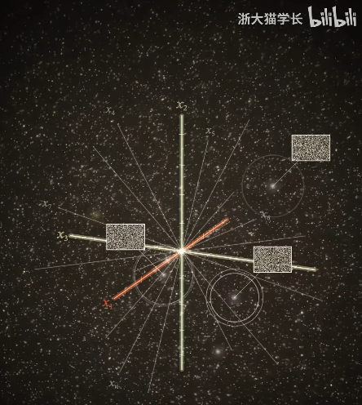
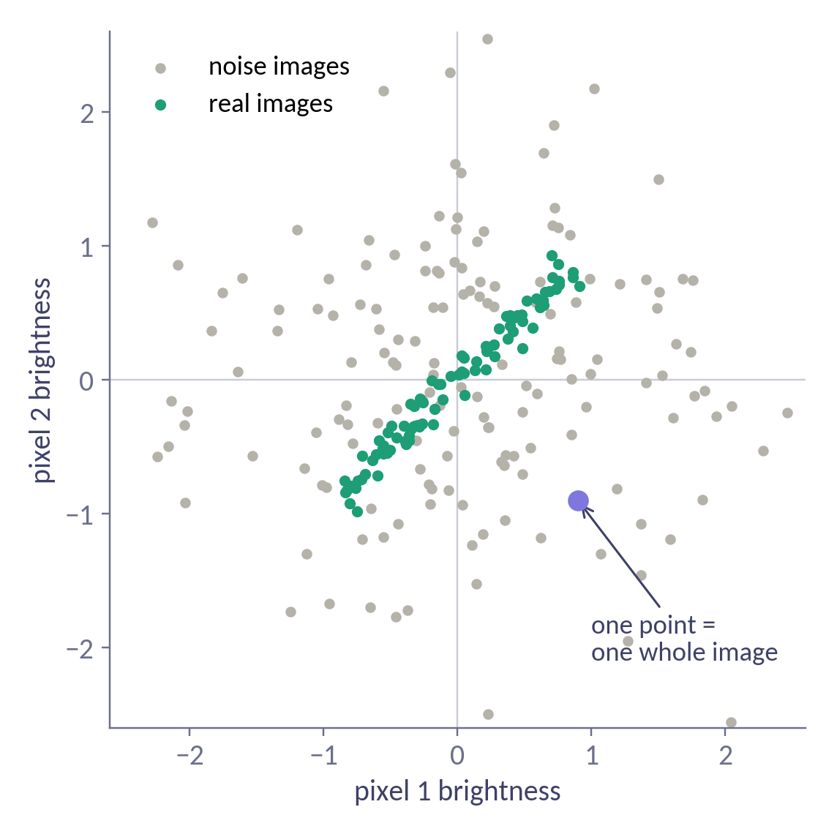
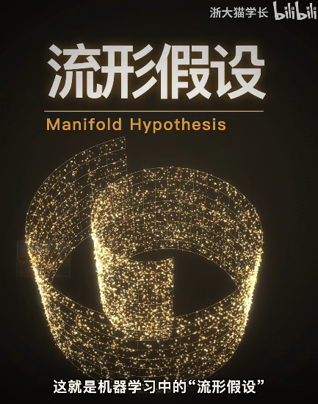
Real images live in a thin region
Shrink the image to just 2 gray pixels: every image becomes a point in a plane.
Noise fills the whole plane
Two pixels with no relation to each other
Real images hug the diagonal
Neighboring pixels have similar brightness
Generation = move a point from the gray cloud onto the green band. In 12,288 dimensions the rule is the same, just impossible to draw.
Notes:
缩到 2 个像素的灰度图，一张图就是平面上的一个点。灰点是噪声，散满整个平面；绿点是真实图片，相邻像素亮度相近，所以挤在对角线附近。可以问大家：(0.9, −0.9) 这个点是什么图？是左亮右暗的图，不在绿带上，不像真实图片。推广到 12288 维：噪声是一团云，真实图片只占一个极薄的区域。生成就是把点从云里挪到薄区域里。

Slide 4
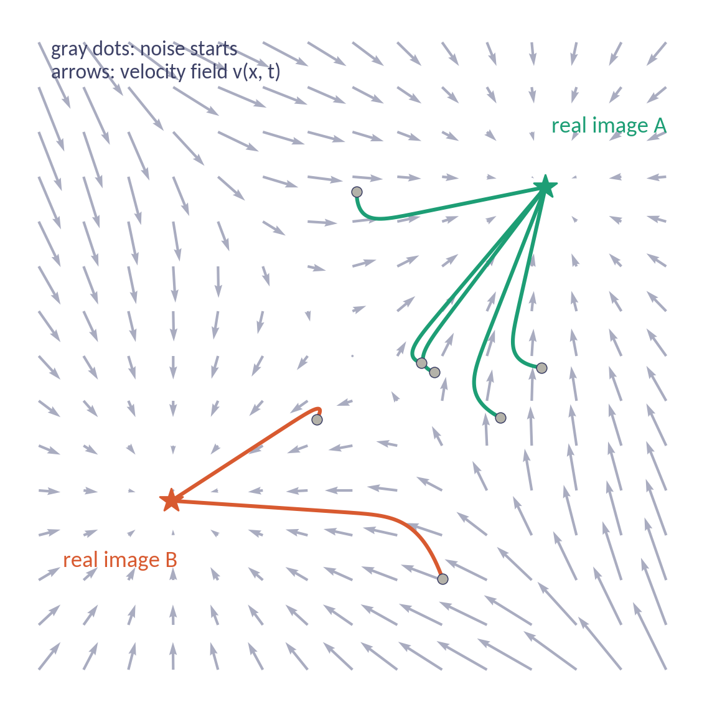
Generation = follow the arrows
A network v(x, t) gives an arrow at every point and time. Start from noise and step along the arrows:
x = torch.randn(64, 64, 3) # noise
for k in range(N):
t = k / N
x = x + (1/N) * v(x, t)
# x is now an image
N
N steps = N network calls
Fewer steps means faster generation
=
Same noise → same image
Different images come from different starting noise
Notes:
速度场是一个函数 v(x, t)：输入当前的图和时刻，输出一张同样大小的方向图。这就是要训练的网络（U-Net 或 Transformer）。t 只是进度条，0 是噪声，1 是图片。生成就是这个循环，数学上叫解 ODE（Euler 方法）。每一步调用一次网络，步数决定速度。过程是确定性的：同一张噪声永远生成同一张图。所以整个问题归结为：怎么训练出 v。图中箭头是 t=0.4 时刻的速度场快照。

Slide 5
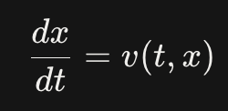
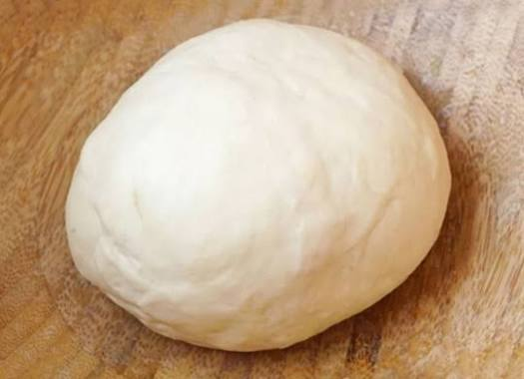
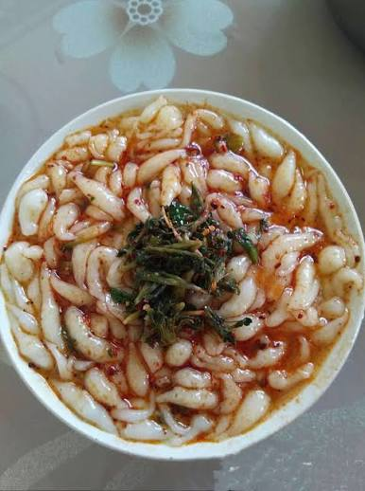
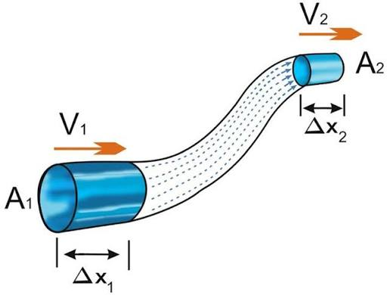
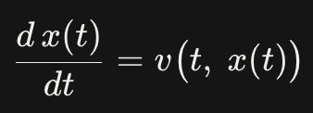
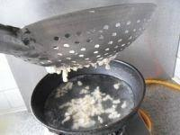
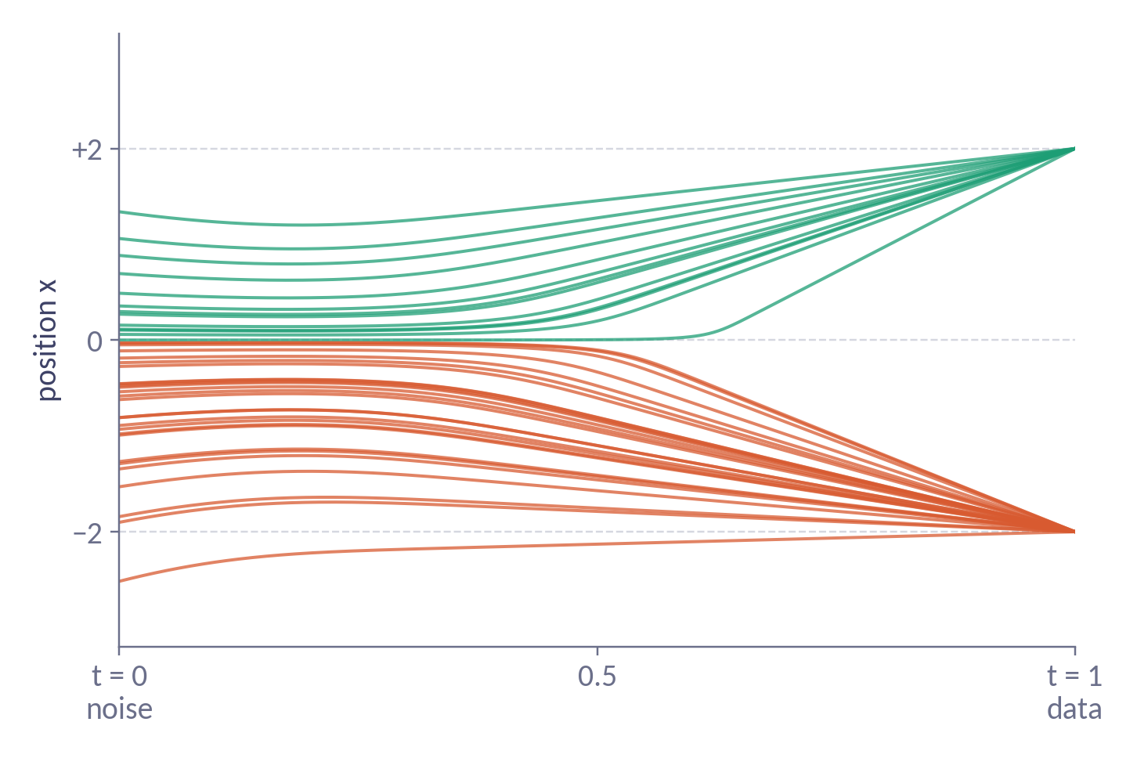
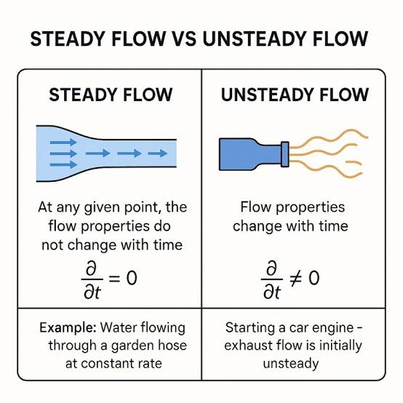
面鱼
Mian Yu
Fish style
noodle
t
In x alone, v(t, x) changes with t: unsteady.
In (t, x) space-time, trajectories are fixed streamlines: steady, so they never cross.

Slide 6
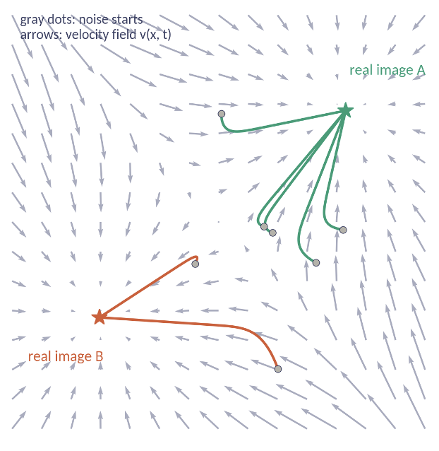
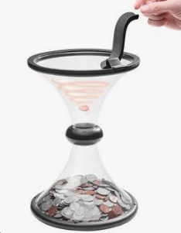
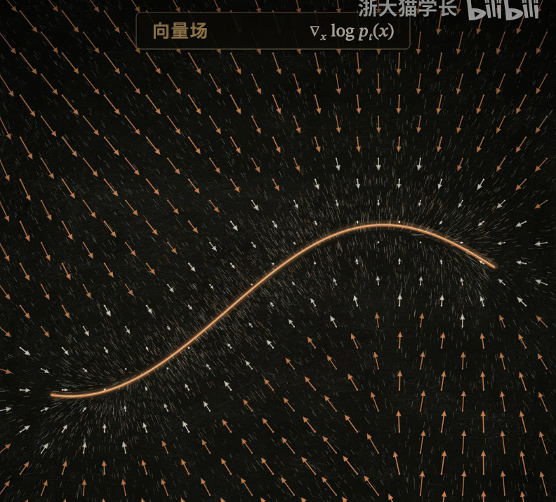
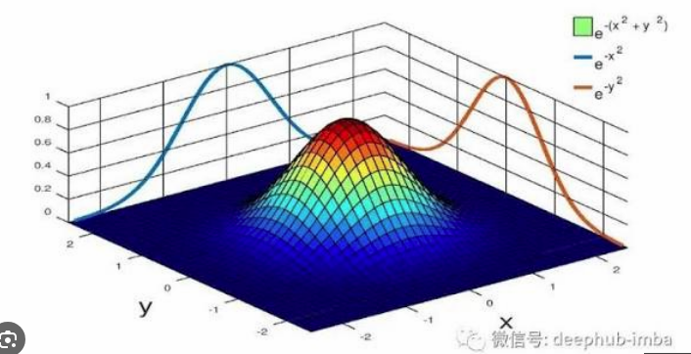
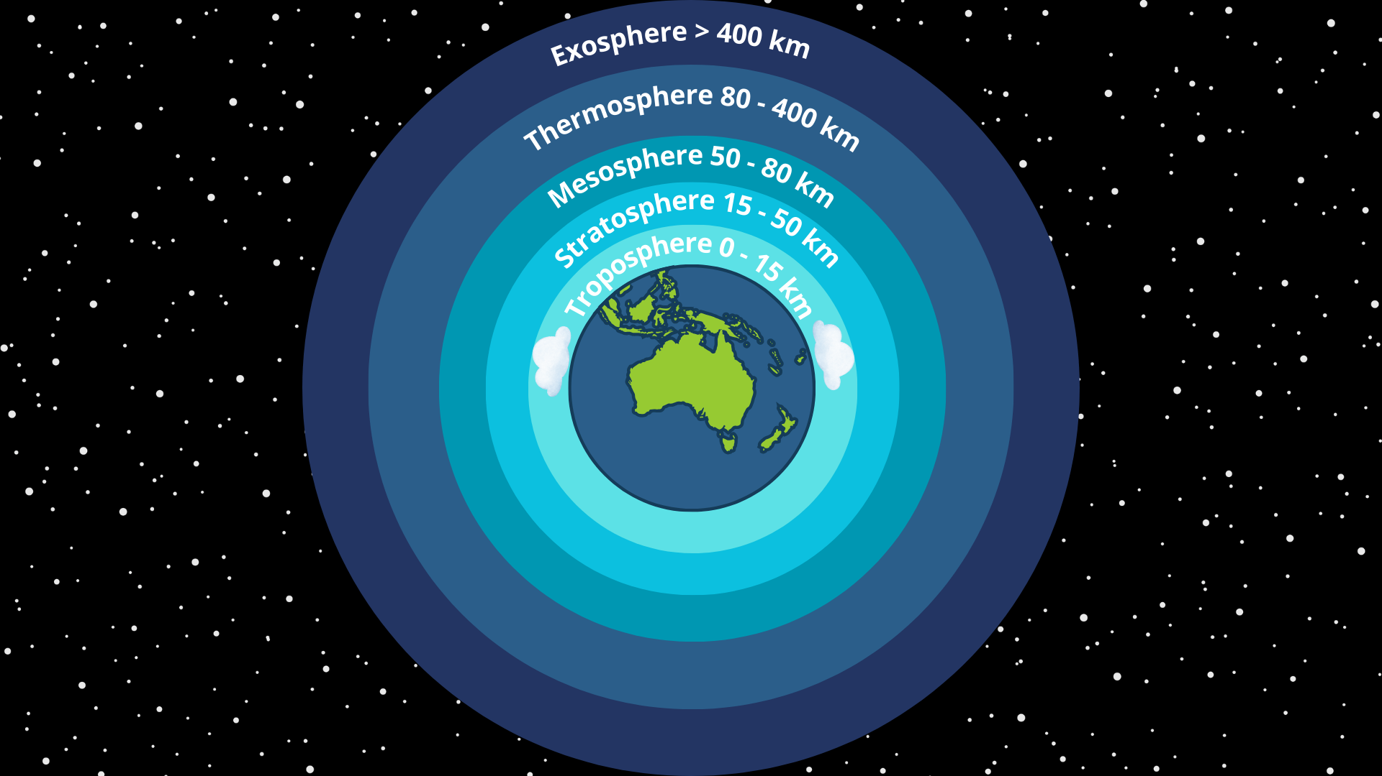


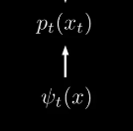
t
DDPM (Reach your lowest potential!)
Score Matching （May the force be with you!）
Flow Matching(顺流而下Go with the flow！)
DDPM derives its loss from “lowering the potential at the data,” but what the network actually fits is the force field at each time step.
Notes:
Score matching https://www.bilibili.com/video/BV135po6zEHq/?spm_id_from=333.337.search-card.all.click&vd_source=261121c37060417ec7b13c9377313abe

Slide 7
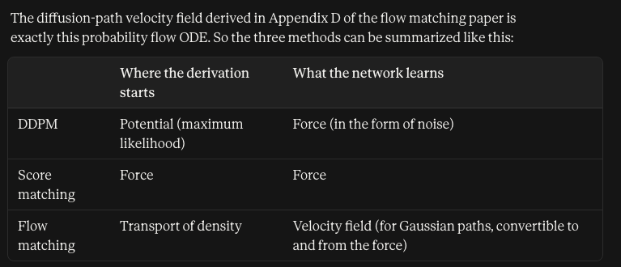

Slide 8
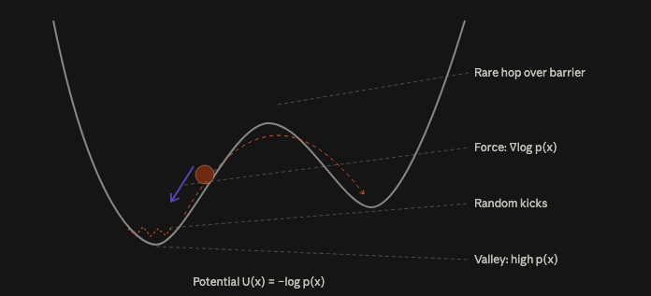
Score matching
Langevin dynamics describes a particle on an energy landscape that slides downhill under a force while being constantly kicked by random collisions. Run it long enough, and the fraction of time the particle spends at each location follows the Boltzmann distribution p(x) ∝ e^{−U(x)}. Diffusion models borrow it as the answer to the question “if I know the score, how do I sample?”

Slide 9
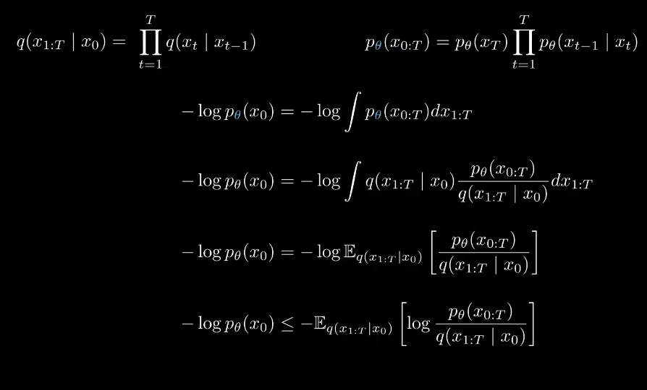
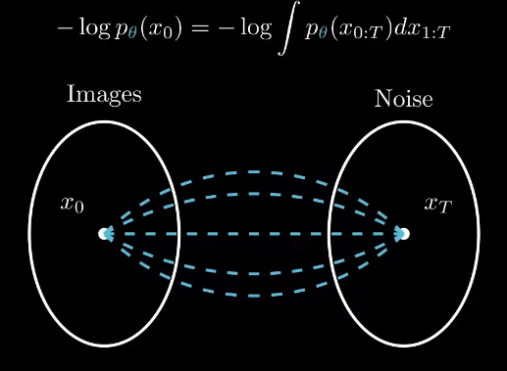
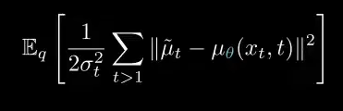
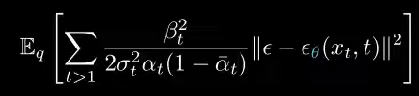
Evidence Lower Bound ELBO
requires integrating（marginalizing） over all paths（latent trajectories）
An expectation is a weighted average
The log is a nonlinear function.
Notes:
x_{1:T} 是 x₁, x₂, …, x_T 的简写，表示整条加噪轨迹上除了起点以外的所有中间状态。x_{0:T} 则把起点 x₀ 也包括进去。如果 T = 1000，每个 x_t 都是一张 12288 维的图，那么 x_{1:T} 就是一千张图连在一起，总共一千多万个数。
q(x1:T|x0)它读作"给定 x₀ 时，x₁ 到 x_T 的联合概率"，意思是：从一张真实图片 x₀ 出发，加噪过程走出某一条具体轨迹 x₁, x₂, …, x_T 的概率。
p_theta(x0:T)
模型按上面这个流程生成时，恰好走出某一串特定的图 (x₃, x₂, x₁, x₀) 的概率有多大
期望本身可以用采样估计：抽几条加噪路径，把比值平均一下。但问题是外面还套着一个 log。用少量样本估出来的平均值有误差，取了 log 之后，log(估计的平均) 的期望并不等于 log(真正的平均)，结果是有偏的。而且这个比值在高维里波动极大，少量样本估计的平均值很不稳定。所以这一行虽然是等式，实际训练中不用它。
最后一行是"对 log 求平均"。随便抽一条加噪路径，算出括号里的 log 值，它就是整个期望的一个无偏估计。抽得越多越准，但训练时每次抽一条也没问题，因为几百万步训练会自动把误差平均掉（和 flow matching 用单条直线训练是同一个道理）。

Slide 10


ψ_t(x)流映射（flow map）where is x0 at time t.

Slide 11
Training: pair randomly, draw a line
1
2
3
4
Sample a real image
Sample noise
Mix along a line
Regress the velocity
x₁ from the dataset
x₀, unrelated to x₁
xₜ = (1 − t)·x₀ + t·x₁
target = x₁ − x₀
No one knows which noise should become which image, so we just pretend.
x1 = sample_from_dataset()
x0 = torch.randn_like(x1)
t = torch.rand(1)
xt = (1 - t) * x0 + t * x1
loss = ((v(xt, t) - (x1 - x0))**2).mean()
The paper’s headline claim
Simulation-free training of CNFs: older methods solved an ODE at every training step; here it is plain regression.
Notes:
难点：训练回归网络需要标准答案，但没人知道这张噪声该变成哪张图，路上每个位置该往哪走更不知道。论文的办法：随机抽一张真实图、随机抽一张噪声，假装它们是一对，连一条直线，让网络学这条直线的速度（终点减起点）。两点注意：配对完全随机；训练不需要解 ODE，成本和训练分类器差不多。这正是论文的标题级贡献：以前训练 CNF 每一步都要解 ODE，所以做不大；flow matching 把它变成了普通回归。

Slide 12
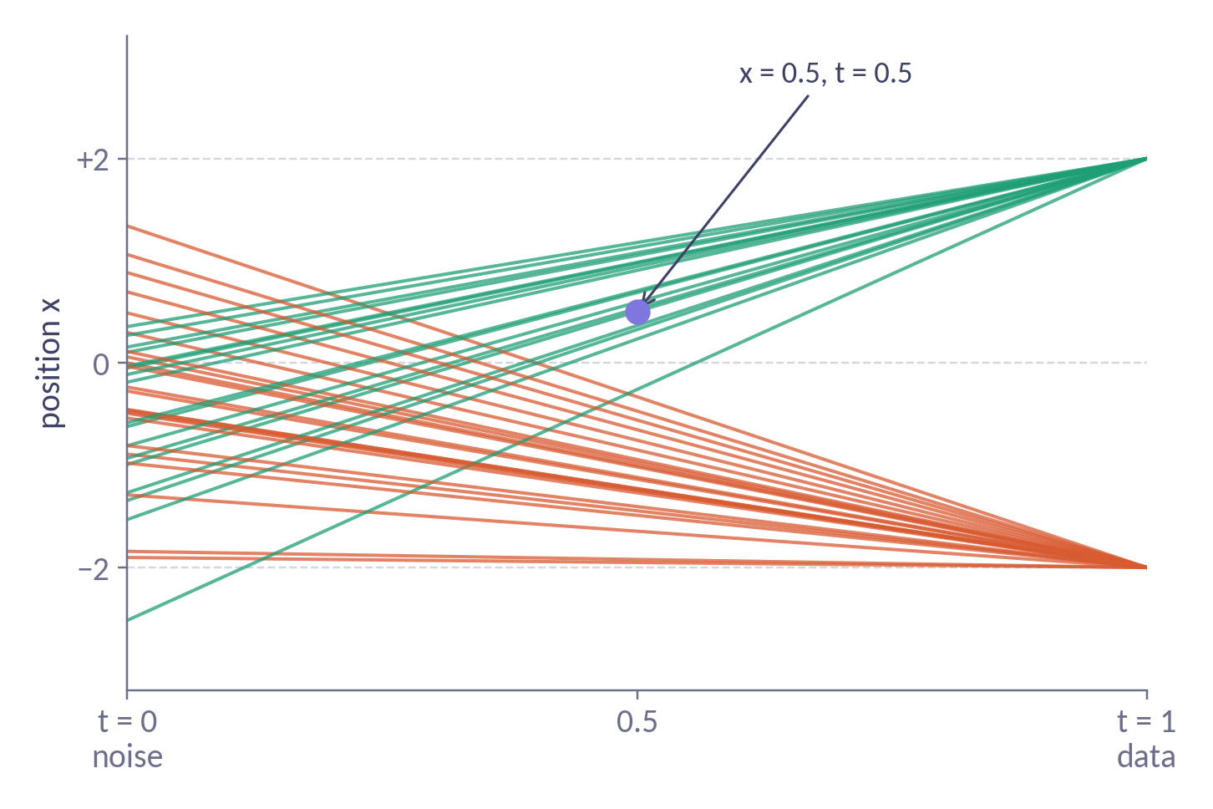
Random lines disagree at the same point
Toy data: only two points, +2 and −2. Look at x = 0.5 at t = 0.5:
+3
lines heading to +2 · about 98%
−5
lines heading to −2 · about 2%
Same input, two labels. Which should the network learn?
Notes:
配对随机，所以同一个位置会有很多条线经过，方向不同。具体看 t=0.5, x=0.5：去 +2 的线，剩 1.5 的距离、0.5 的时间，速度 +3；去 −2 的线，速度 −5。同一个输入有两个矛盾的标签。98% 和 2% 怎么来：t=0.5 时去 +2 的那群分布在 +1 附近，去 −2 的在 −1 附近，宽度都是 0.5。x=0.5 离 +1 一个标准差，离 −1 三个标准差，密度比约 55:1。就是在这个位置数人头。

Slide 13
MSE averages them into one flow
Same input, several labels: MSE learns their average. Averaged paths never cross.
+2.86
0.98 × (+3) + 0.02 × (−5)
In the paper: Theorem 2
L_FM = E‖v(xₜ,t) − uₜ(xₜ)‖²
true average velocity: can’t compute
L_CFM = E‖v(xₜ,t) − (x₁ − x₀)‖²
one line’s velocity: easy
Same gradients, so same trained network
Notes:
机器学习常识：同一个输入有多个标签，均方误差的最优解是标签的加权平均。所以网络在这里学到 0.98×3 + 0.02×(−5) ≈ 2.86，基本朝 +2，被另一边稍微拉回。右图是平均后的流：线不再交叉（ODE 轨迹本来就不能交叉，同一位置只能有一个速度）。开头平、中间分叉，因为一开始两群重叠，速度相互抵消。为什么这个平均流是对的：按目标分群，每群沿直线走都正确；合在一起，总速度就是按密度加权的平均，正是网络学到的（Theorem 1、2）。小结：出题粗糙，平均之后答案精确。右下角是论文的正式说法：L_FM 回归算不出的平均速度，L_CFM 回归单条直线的速度，Theorem 2 说两者梯度相同。

Slide 14
Training differs by only two lines
 | Diffusion (DDPM) | Flow matching
Sample | image, noise, time t | same
How to mix | noise schedule: √aₜ·x₁ + √(1 − aₜ)·ε | straight line: (1 − t)·x₀ + t·x₁
Network predicts | the noise that was added (ε) | the velocity toward the image (x₁ − x₀)
Loss | mean squared error | same
At generation | special sampler converts noise → step | any ODE solver uses v directly
Diffusion asks
“What noise is mixed into this image?” … then a sampler turns that into a step.
Flow matching asks
“Which way should I go from here?”
Notes:
先一句话交代扩散模型：定义一个加噪过程，从真实图片一点点加噪声直到变成雪花，然后训练网络把过程倒过来，即预测混进了什么噪声，生成时一步步去掉。训练循环对比：抽样、均方误差、不需要模拟，都一样。只差两行：怎么混合、预测什么。扩散问'混进了什么噪声'，得到的是该去掉什么，还要换算成往哪走；flow matching 直接问'往哪走'。

Slide 15
The real difference is the path
Diffusion barely moves, then overshoots (3.16 at t = 0.9). Flow matching moves at constant speed.
One family, two choices (Theorem 3)
xₜ = σₜ·x₀ + μₜ(x₁)
Diffusion and straight lines differ only in how μₜ and σₜ change over time
~142 vs ~274
network calls per image on CIFAR-10, flow matching vs DDPM, same network (paper, Table 1)
Straight path → big steps stay accurate → faster generation
Notes:
'怎么混合'这一行决定了路线。一维例子：起点 1，终点 3。flow matching 匀速直线；扩散前半段几乎不动，后半段冲过头到 3.16 再折回（论文 Figure 3、Figure 6 也能看到）。生成要一步步数值积分：直线可以迈大步，弯路要小步。论文实验：同一网络，CIFAR-10 上约 142 次 vs 约 274 次网络调用，质量还更好，训练也更稳定。诚实补充：对高斯路径，预测噪声和预测速度可以互相换算，真正区别是路径：扩散的路线由加噪过程推导出来，没得选；flow matching 可以直接设计路线，选最简单的直线。右上角的公式就是 Theorem 3：所有高斯路径都是 x_t = σ_t x₀ + μ_t，扩散和直线只是 μ_t、σ_t 的选法不同。

Slide 16
One sentence to remember
Pair noise and images at random, draw straight lines, and let mean squared error average them into the right velocity field.
Next: averaged paths are still curved (Rectified Flow) · guidance · latent space
Notes:
回到中心句：flow matching 用随机配对的直线训练速度场，均方误差自动把它们平均成正确方向；和扩散相比训练框架几乎一样，但路径更直，生成更快。小尾巴：每条训练直线是直的，但平均后的真实轨迹是弯的，怎么拉直是 Rectified Flow 等后续工作；guidance、潜空间是课程后面几讲。

Slide 17
Backup: the formal objectives
Flow Matching loss
L_FM(θ) = E ‖vθ(t, x) − uₜ(x)‖²
x drawn from the marginal path pₜ; the true velocity uₜ is unknown
Marginal velocity (eq. 8)
uₜ(x) = ∫ uₜ(x|x₁) · pₜ(x|x₁) q(x₁) / pₜ(x) dx₁
Posterior-weighted average of line velocities
Conditional FM loss
L_CFM(θ) = E ‖vθ(t, xₜ) − uₜ(xₜ|x₁)‖²
x₁ from data, x₀ from noise: one line at a time
Theorems 1 & 2
∂ₜpₜ + ∇·(pₜuₜ) = 0
∇θ L_FM = ∇θ L_CFM
uₜ moves noise to data; both losses train the same network
Notes:
备用页，有人追问严格表述时再放。L_FM 是想要的损失，但边缘速度场 u_t(x) 是对整个数据集的后验平均，算不出来。L_CFM 每次只用一条直线的速度，可以直接算。Theorem 1：边缘速度场满足连续性方程，所以确实能把噪声分布运到数据分布。Theorem 2：两个损失只差一个与 θ 无关的常数（目标本身的方差），梯度相同。

Slide 18
Backup: Gaussian paths (Theorem 3)
pₜ(x|x₁) = N(x | μₜ(x₁), σₜ(x₁)² I)
xₜ = σₜ·x₀ + μₜ
uₜ(x|x₁) = μ′ₜ + (σ′ₜ / σₜ)(x − μₜ)
Velocity = center motion + uniform stretch about the center
Every particle keeps its “how many σ from the center” label. The simplest of the infinitely many fields that produce the same Gaussian path.
Path | μₜ(x₁) | σₜ(x₁) | Behavior
Optimal transport | t·x₁ | 1 − (1 − σ_min)·t | straight line, constant speed; target x₁ − (1 − σ_min)·x₀
VP diffusion | α₁₋ₜ·x₁ | √(1 − α²₁₋ₜ) | stalls early, rushes late, can overshoot
VE diffusion | x₁ | σ₁₋ₜ | only shrinks noise; reaches pure noise only asymptotically
Notes:
Theorem 3：对高斯条件路径，最简单的流是 x_t = σ_t x₀ + μ_t，即中心平移加均匀伸缩，每个粒子离中心几个标准差保持不变。速度场 = 中心速度 + 伸缩率 × 离中心距离（类似哈勃定律）。OT 路径代入得到恒定速度 x₁ − (1−σ_min)x₀；VP、VE 扩散代入得到论文式 (17)、(19)，并且和扩散模型的 probability flow ODE 一致（附录 D）。

Slide 19
Backup: links and limits
1
2
3
Where 98% comes from
Diffusion is also an ODE
Limits the paper admits
At t = 0.5 each group is Gaussian with width 0.5, centered at ±1. x = 0.5 is 1σ from +1 and 3σ from −1, so the density ratio is e⁴ ≈ 55 : 1.
Fokker–Planck rewritten as a continuity equation gives wₜ = fₜ − (gₜ²/2)∇log pₜ (Appendix D): same path, deterministic particles.
Each conditional line is straight, but the averaged (marginal) flow is curved and not globally optimal transport. Experiments are mostly unconditional.
Notes:
备用页。1）98% 的来历：两群粒子在 t=0.5 都是宽度 0.5 的高斯，x=0.5 离 +1 一个标准差、离 −1 三个标准差，密度比 e⁴≈55。2）扩散模型也有确定性的 ODE 版本：Fokker–Planck 方程改写成连续性方程，等效速度 f − g²/2 ∇log p，路径相同。3）论文承认的局限：条件路径是直的，但边缘路径是弯的，也不是全局最优传输；实验主要是无条件生成。后续的 Rectified Flow、minibatch OT 在解决第一个问题。

